Slide 1
Sequence Diagrams

Slide 2
Sequence Diagrams
Describe the flow of messages, events, actions between objects
Show concurrent processes and activations
Show time sequences that are not easily depicted in other diagrams
Typically used during analysis and design to document and understand the logical flow of your system
Emphasis on time ordering!

Slide 3
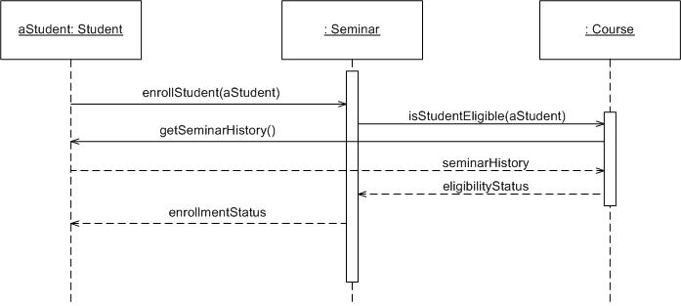
Sequence Diagram
Coming up: Components

Slide 4

Sequence Diagram
Time Increasing -->
All lines should be horizontal to indicate instantaneous actions. Additionally if ActivityA happens before ActivityB, ActivityA must be above activity A
Lower = Later!
Coming up: Components

Slide 5
Diagonal Lines
:Student
:Registration System
Time=A
GetDetails()
Time=B
What does this mean?
Do you typically care?

Slide 6
Components
Objects: aStudent is a specific instance of the Student class
Generic (unnamed)
objects
Generic (unnamed)
objects of class type Seminar
and Course
Specific
Instance of an
Object
Coming up: Components

Slide 7
Components
execution
lifeline
Coming up: Components

Slide 8
Components
Method call
Return value
Coming up: Components

Slide 9
Components
c : Client
o : ODBCProxy
create()
: Transaction
setActions(a, b, c)
setValues(a, 3, 4)
setValues(b, c, 7)
(committed)
destroy()
create()
destroy()
Synchronous message
Asynchronous message
Return message
Coming up: Components: Guards

Slide 10
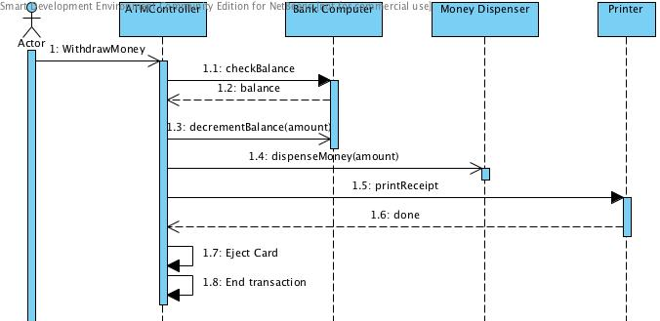
Async Message Example
There are problems here… what are they?
Synchronous message
Asynchronous message
Return message
Coming up: Components: Guards

Slide 11
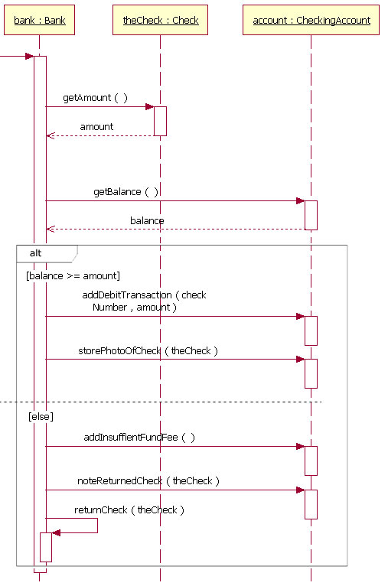
Components: alt/else
Coming up: Components: option

Slide 12
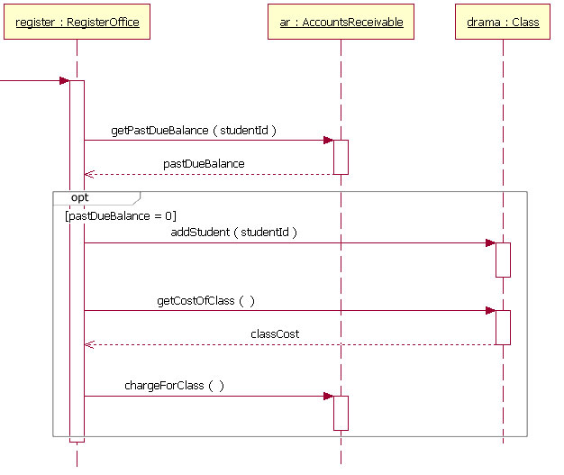
Components: option
Coming up: Components: loop

Slide 13
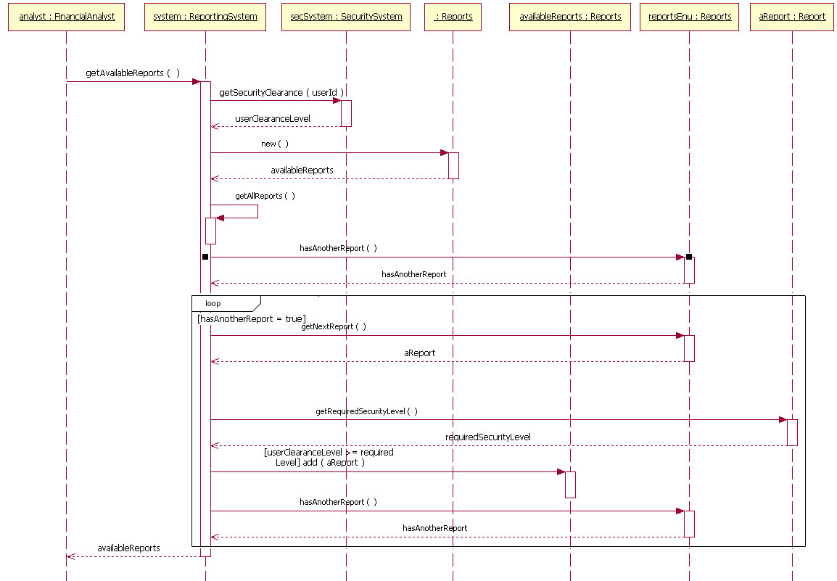
Components: loop
Coming up: In class exercise

Slide 14
Rules of thumb
Rarely use options,loops,alt/else
  These constructs complicate a diagram and make them hard to read/interpret.
  Frequently it is better to create multiple simple diagrams
Create sequence diagrams for use cases when it helps clarify and visualize a complex flow
Remember: the goal of UML is communication and understanding

Slide 15
Summary
Sequence diagrams model object interactions with an emphasis on time ordering
Method call lines
  Must be horizontal!
  Vertical height matters! “Lower equals Later”
  Label the lines
Lifeline – dotted vertical line
Execution bar – bar around lifeline when code is running
Arrows
  Synchronous call (you’re waiting for a return value) – triangle arrow-head
  Asynchronous call (not waiting for a return) – open arrow-head
  Return call – dashed line
Coming up: In class exercise

Slide 16
References
Example diagrams from: http://www.ibm.com/developerworks/rational/library/3101.html
Coming up: References

